Slide 1


Personal Lazada Spending Analysis (2024)
Prepared by: Janice Delos Santos
Date: February 24, 2024
This Photo by Unknown Author is licensed under CC BY-NC

Slide 2
Agenda
Business Tasks
Data sources
Data Cleaning and Manipulation
Summary of Analysis
Visualization and Key Findings
Recommendation
Introduction

Slide 3
Introduction

Slide 4

Introduction
The objective is to analyze my purchasing patterns from year 2024, assess the impact of discounts and free shipping, and identify strategies to optimize future saving.

Slide 5

Business Tasks

Slide 6
Business Tasks
1. Calculate the overall savings from free delivery and discounts.
2. Determine which discounts, such coupons and coins, work best and which free delivery deals are most advantageous.
3. Identify the main Lazada spending trends.
4. Create doable plans to optimize future savings.
5. The goal is to figure out how I can use Lazada to make more economical and knowledgeable purchases.

Slide 7

Data Sources

Slide 8
Data Sources
My purchase data, drawn directly from my history, is highly reliable, original, and reflects current spending habits.

Slide 9
The dataset is structured as a table with the following columns and its descriptions.
order_number | item_purchased | original_price | price_after_discount | quantity
category | mode_of_payment | seller_name | placed_on | shipped_on
delivered_on | courier | location | discounts | free_shipping

Slide 10
Data Cleaning and Manipulation

Slide 11

Cleaning
Standardized date formats, spacing, capitalization, spelling etc.
Ensured consistent discount type naming.
Checked for accurate count of order number.
Checking correct dates.
Format the column depend on their data type

Slide 12
Manilpulation
Average delivery time | Total summarize values from day of the week deliveries | Discount Amount | Total_amount
Average monthly savings | Total Spending in 2024 | Number of days for delivery(delivery time) | Total Discount per Order
Created a calculated field for data manipulation

Slide 13
Summary Of Analysis

Slide 14
➔ Total Savings: 6,425 discount ➔ Average Savings per Order: 16.48 ➔ Total Item Purchased: 575 items ➔ Total Spending: 128,585 ➔ Average month spending:10,715
Financial Summary

Slide 15
➔ Most Frequent Discount Type: Coins and voucher ➔ Free Shipping Frequency: 190 orders(YES), 13 orders(NO)
Discount & Shipping Analysis

Slide 16
➔ Top Product Categories: Garden ➔ Spending Trends Over Time: Usually purchased on the 21st of the month ➔ Items with the largest discount: Dell Inspiron 15 (Total Discount: 1000)
Spending Patterns

Slide 17

Visualization

Slide 18
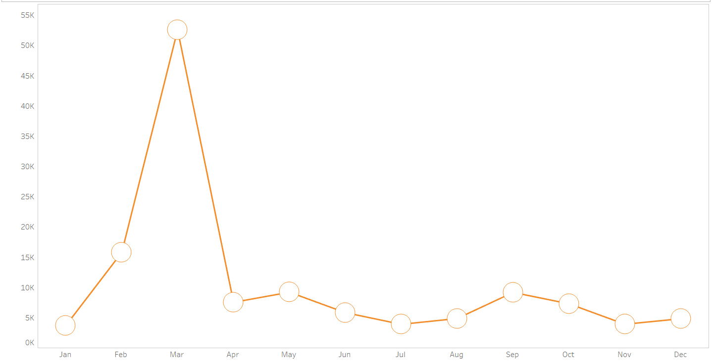
Monthly Spending Summary

Slide 19
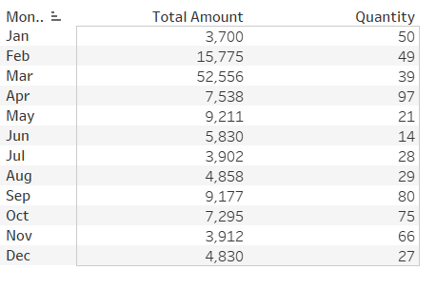
Monthly Spending Summary

Slide 20
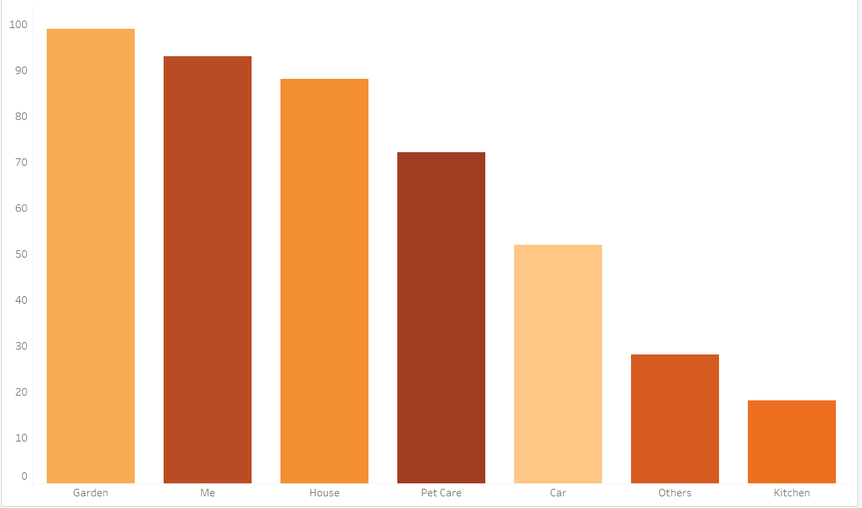
Most Purchased Category by Units

Slide 21
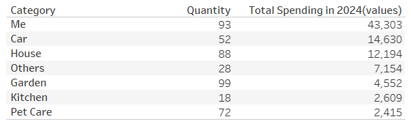
Most Purchased Category by Units

Slide 22
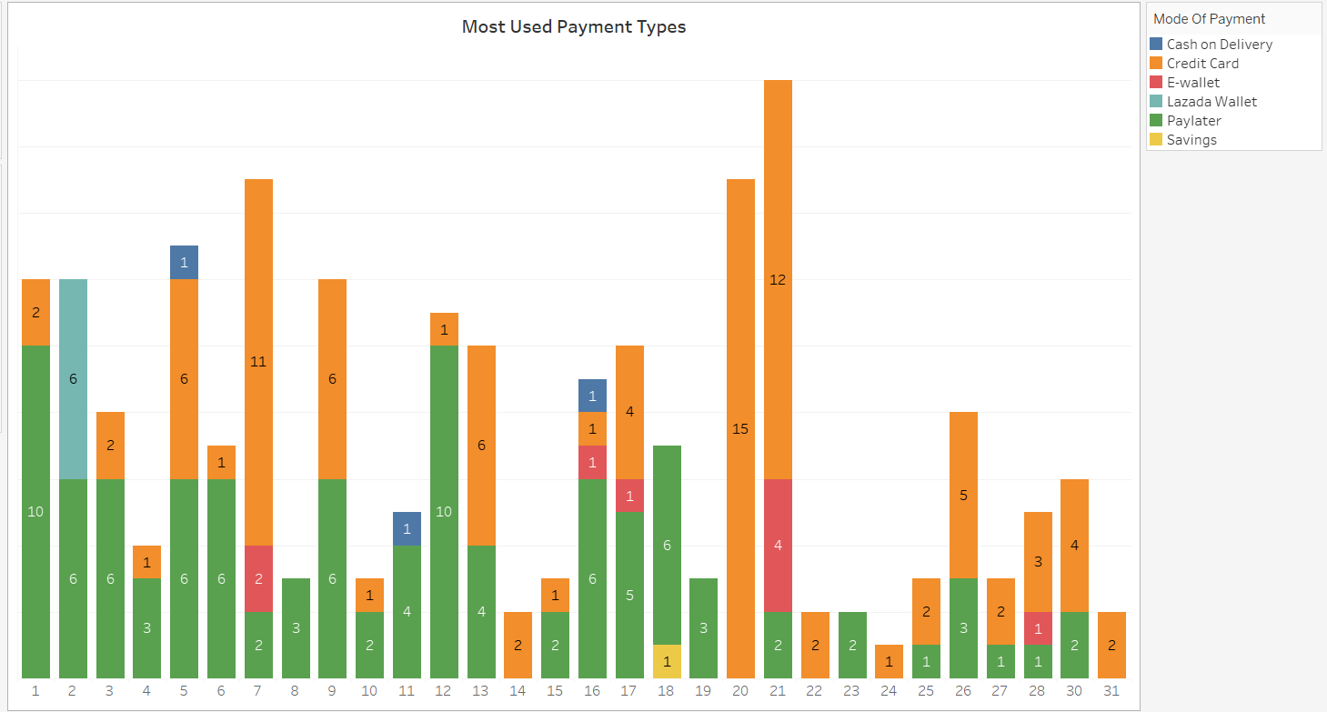
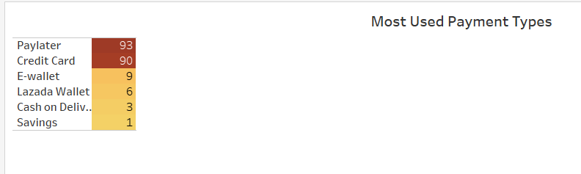
Most Frequent Payment Method

Slide 23
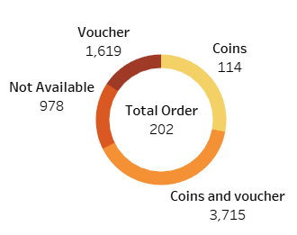
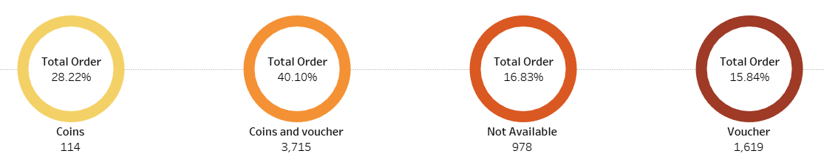
Order Discount

Slide 24
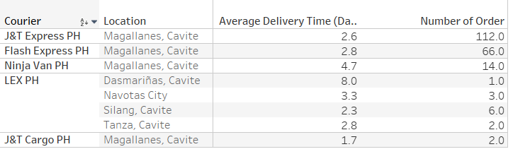
Order Discount

Slide 25
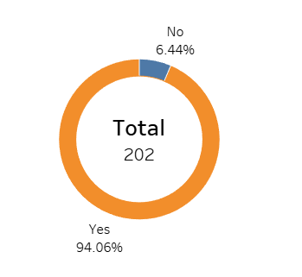
Shipping Free

Slide 26
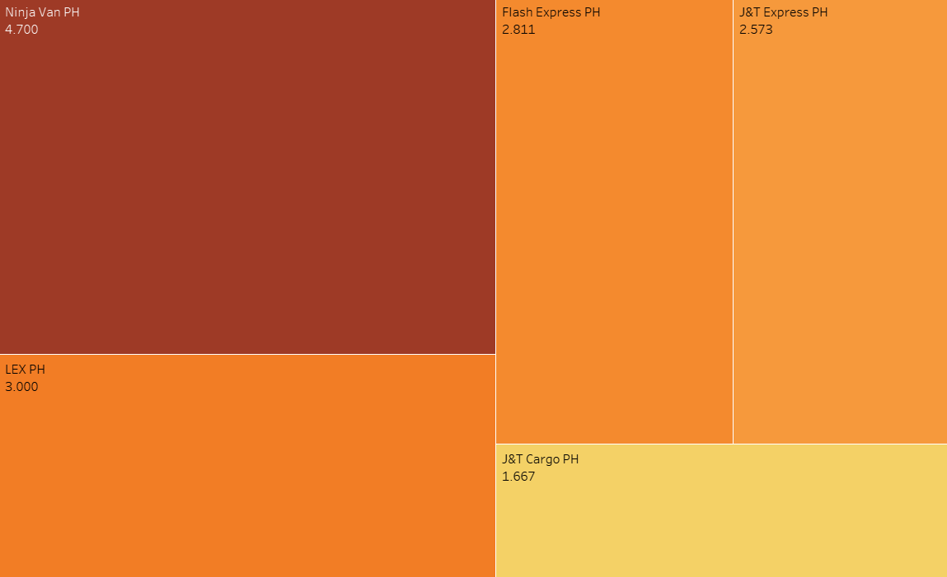
Average Delivery Time by Courier

Slide 27
Average Delivery Time by Courier

Slide 28
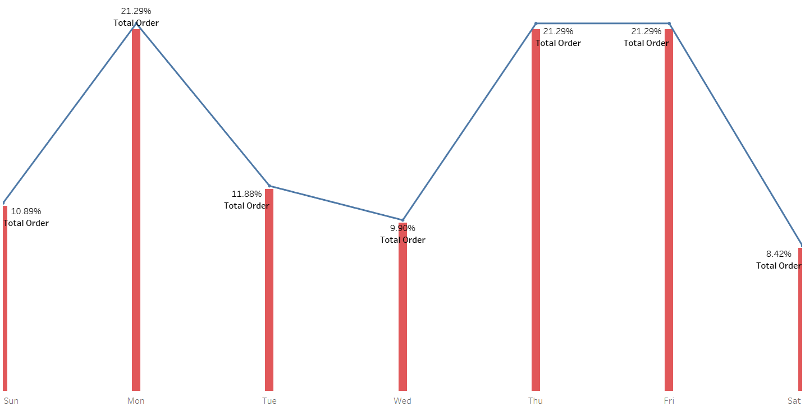
Most Frequent Shopping Day

Slide 29
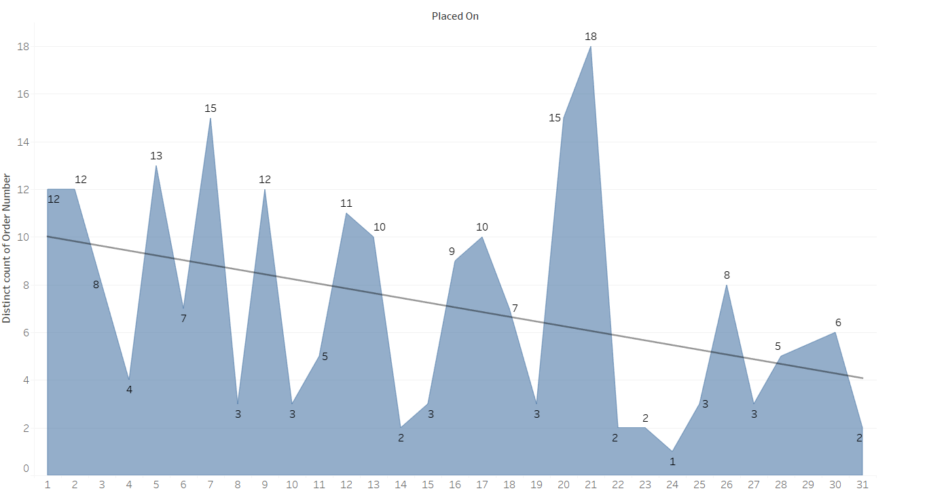
Most Frequent Shopping Day

Slide 30

Recommendations

Slide 31
1. Discount and Spending Analysis:
➔ Prioritize Purchases from Highly-Rated Sellers
➔ Optimize Discount Utilization
➔ Conduct Thorough Comparative Analyses

Slide 32
2. Shipping and Delivery
➔ Prioritize Sellers Based on Location for Expedited Delivery
➔ Scrutinize Shipping Fees Before Finalizing Purchases

Slide 33
3. Payment and Financial Management
➔ Continue utilizing 'Pay Later' and credit card options to maintain financial flexibility and optimize payment schedules.
➔ Maximize e-wallet savings to take advantage of the 6% per annum interest rate.
➔ Create a monthly budget, and track spending to ensure that the spending does not exceed the budget

Slide 34
Thank You

